Slide 1
Module 1: Properties and Handling of Particulate Solids (Chapter 28)
Lecture 4
Somak Chatterjee

Slide 2
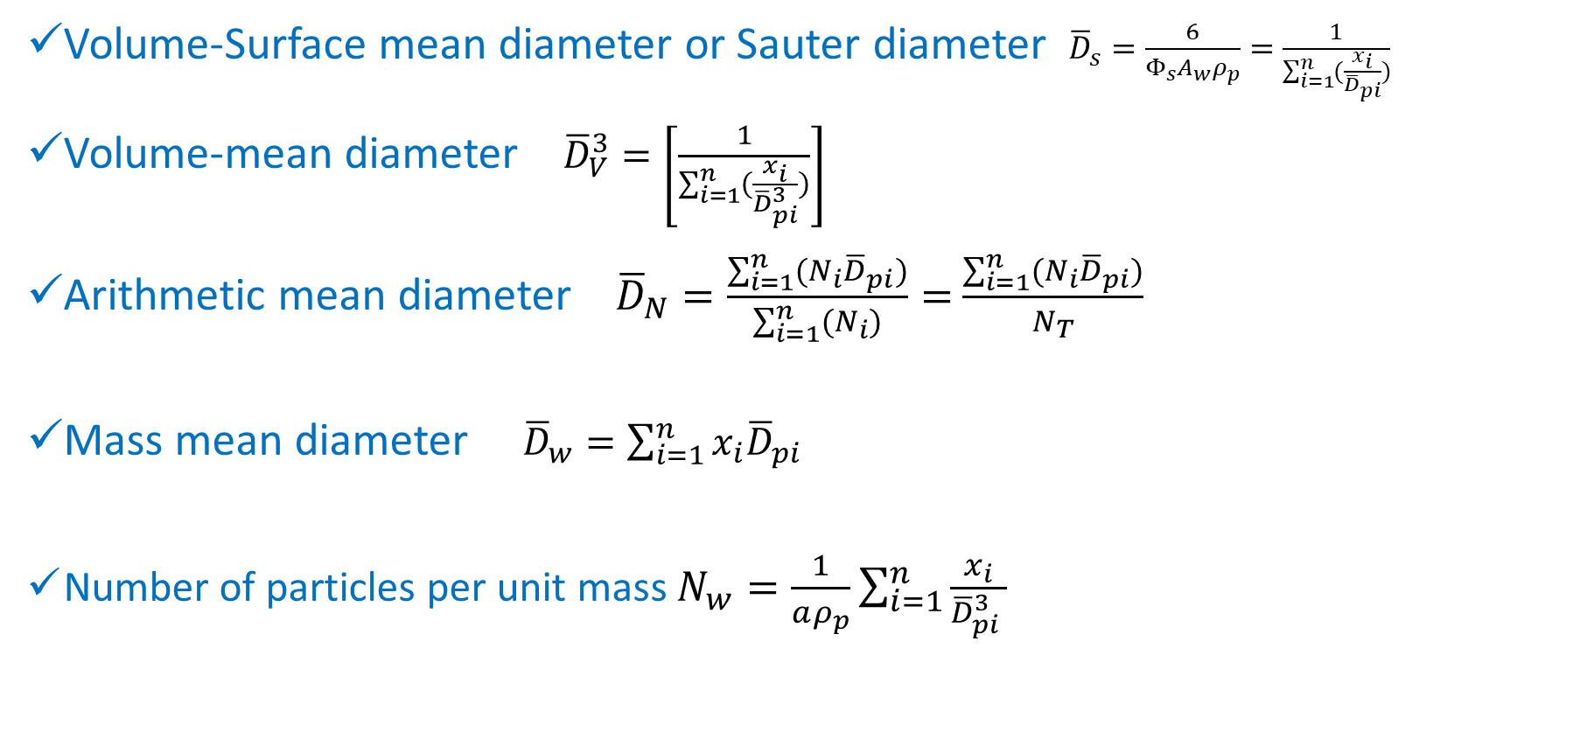
Summary of Average Particle Sizes
Volume-Surface mean diameter or Sauter diameter ${\overline{D}}_{s}=\frac{6}{Φ_{s}A_{w}ρ_{p}}=\frac{1}{\sum_{i=1}^{n}{(\frac{x_{i}}{{\overline{D}}_{pi}})}}$
Volume-mean diameter ${\overline{D}}_{V}^{3}=\left[\frac{1}{\sum_{i=1}^{n}{(\frac{x_{i}}{{\overline{D}}_{pi}^{3}})}}\right]$
Arithmetic mean diameter ${\overline{D}}_{N}=\frac{\sum_{i=1}^{n}{(N_{i}{\overline{D}}_{pi})}}{\sum_{i=1}^{n}{(N_{i})}}=$ $\frac{\sum_{i=1}^{n}{(N_{i}{\overline{D}}_{pi})}}{N_{T}}$
Mass mean diameter ${\overline{D}}_{w}=\sum_{i=1}^{n}{x_{i}{\overline{D}}_{pi}}$
Number of particles per unit mass $N_{w}=\frac{1}{aρ_{p}}\sum_{i=1}^{n}{\frac{x_{i}}{{\overline{D}}_{pi}^{3} }}$

Slide 3

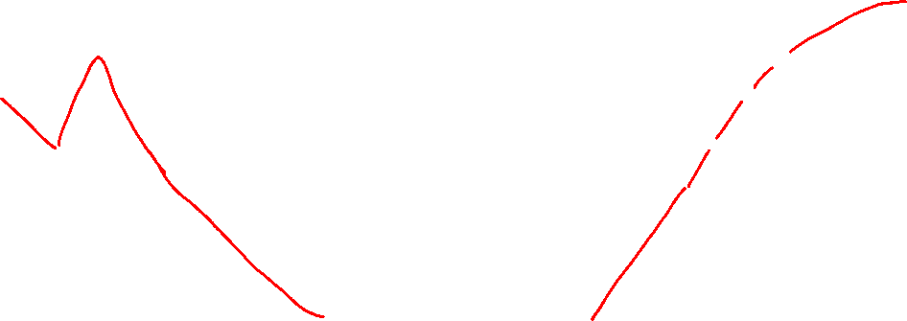

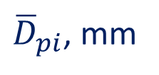

Differential Analysis
Cumulative Analysis
$$x_{i}$$
Cumulative fraction smaller than ${\overline{D}}_{pi}$
${\overline{D}}_{pi}$, mm
${\overline{D}}_{pi}$, mm

Slide 4
PROPERTIES OF PARTICULATE MASSES
Masses of dry and not sticky solid particles have many of the properties of a fluid
Solid masses have the following distinctive properties:
The pressure is not the same in all directions.
A shear stress applied at the surface of a mass is transmitted throughout a static mass of particles unless failure occurs.
The density of the mass vary depending on the degree of packing of the grains.
Before a mass of tightly packed particles can flow, it must increase in volume to permit interlocking grains to move past one another.
When granular solids are piled up on a flat surface, the sides of the pile are at a definite reproducible angle with the horizontal.

Slide 5
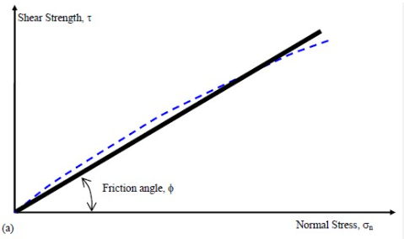
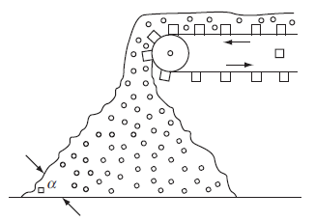
PROPERTIES OF PARTICULATE MASSES
Angle of repose
Angle of internal friction

Slide 6
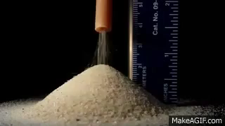
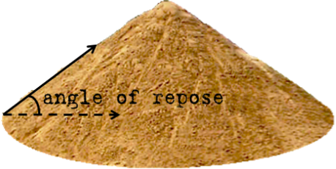
PROPERTIES OF PARTICULATE MASSES

Slide 7
PROPERTIES OF PARTICULATE MASSES
Depending on their flow properties, particulate solids are divided into two classes
Noncohesive
  materials like grain, dry sand, and plastic chips readily flow out of a bin or silo.
Cohesive solids
  such as wet clay, are characterized by their reluctance to flow through openings.

Slide 8
Storage and Conveying of Solids
Bulk Storage
  Coarse solids like gravel and coal are stored outside in large piles, unprotected from the weather.
  Outdoor storage can lead to environmental problems such as dusting or leaching of soluble material from the pile.
Bin Storage
  Solids that are too valuable or too soluble to expose in outdoor piles are stored in bins, hoppers, or silos.

Slide 9
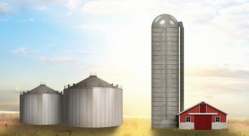
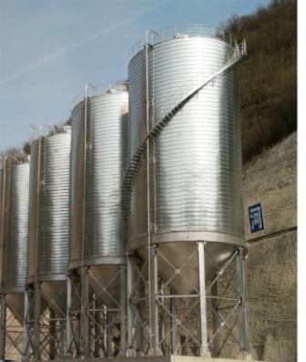
Storage and Conveying of Solids
Bin
Silo
Hopper
Source: https://www.ilfbpartners.com/

Slide 10
Storage and Conveying of Solids
Pressures in bins and silos
  When granular solids are placed in a bin or silo, the lateral pressure exerted on the walls at any point is less than predicted from the head of material above that point.
  There usually is friction between the wall and the solid grains, and because of the interlocking of the particles, the effect of this friction is felt throughout the mass.
  The frictional force at the wall tends to offset the weight of the solid and reduces the pressure exerted by the mass on the floor of the container.
  The vertical pressure on the vessel floor or the packing support is much smaller than that exerted by a column of liquid of the same density and height.

Slide 11
Storage and Conveying of Solids
Flow out of bins
Solids tend to flow out of any opening near the bottom of a bin but are best discharged through an opening in the floor.
Flow through a side opening tends to be uncertain and increases the lateral pressure on the other side of the bin while the solids are flowing.
A bottom outlet is less likely to clog and does not induce abnormally high pressures on the wall at any point.

Slide 12
Conveying System
Pneumatic conveying system: (a) typical multiple-inlet system; (b) nozzle detail

Slide 13
Conveyors
Common devices for transportation include
  belt conveyors and bucket elevators,
  closed-belt conveyors with zipperlike fasteners,
  drag and flight conveyors.
These all include a return leg that carries the empty belt or chain back from the discharge to the loading point.
Vibrating conveyors, Pneumatic conveyors and screw conveyors have no return leg but only operate over relatively short distances.

Slide 14
Mixing of Solids
The mixing of solids, whether free flowing or cohesive, resembles to some extent the mixing of low-viscosity liquids.
Both processes intermingle two or more separate components to form a more or less uniform product.
Some of the equipment normally used for blending liquids may, on occasion, be used to mix solids.

Slide 15
Mixing of Solids
Measures of mixer performance
  Mixing is harder to define with solids and pastes than it is with liquids
  Quantitative measures of mixing is based on statistical procedures
    sometimes used to evaluate mixer performance.
  These procedures are based on analyses of spot samples taken from the mix at various times.
  A mixture in which one component is randomly distributed through another is said to be completely mixed.

Slide 16
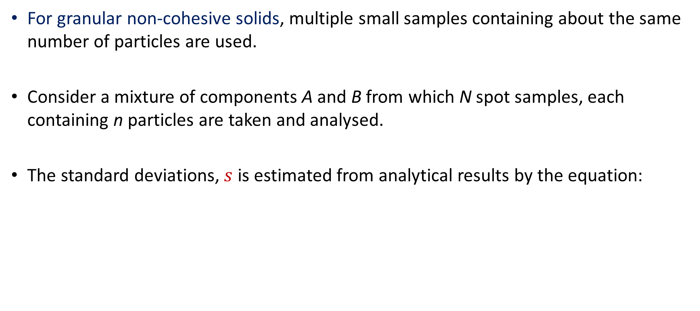
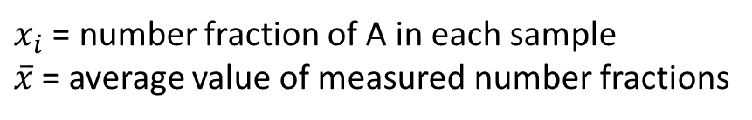
Mixing of Solids: granular non cohesive solids
For granular non-cohesive solids, multiple small samples containing about the same number of particles are used.
Consider a mixture of components A and B from which N spot samples, each containing n particles are taken and analysed.
The standard deviations, $s$ is estimated from analytical results by the equation:
$x_{i}$ = number fraction of A in each sample
$\overline{x}$ = average value of measured number fractions

Slide 17
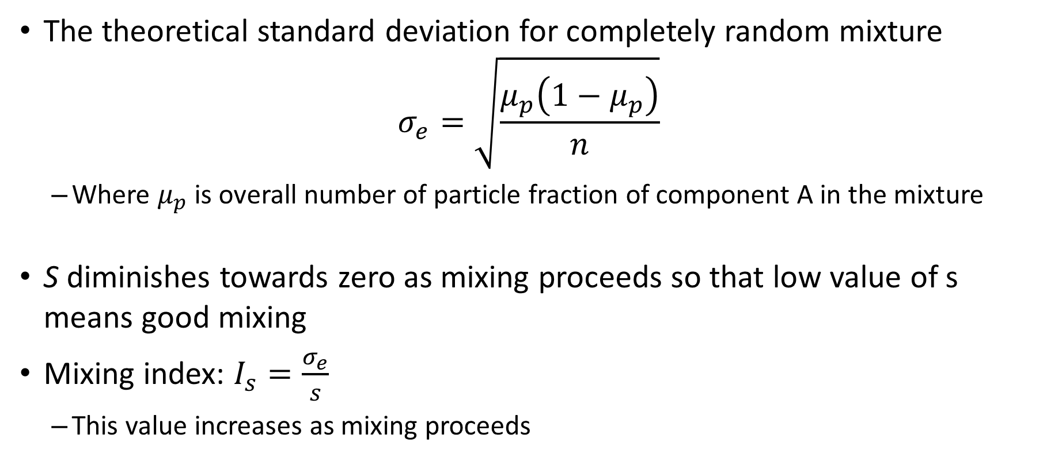
Mixing of Solids: granular non cohesive solids
The theoretical standard deviation for completely random mixture
$$σ_{e}=\sqrt{\frac{μ_{p}\left(1−μ_{p}\right)}{n}}$$
  Where $μ_{p}$ is overall number of particle fraction of component A in the mixture
S diminishes towards zero as mixing proceeds so that low value of s means good mixing
Mixing index: $I_{s}=\frac{σ_{e}}{s}$
  This value increases as mixing proceeds

Slide 18

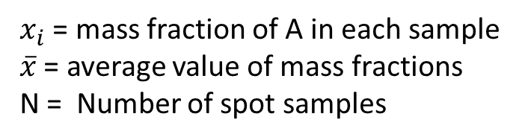
Mixing of Solids: cohesive solids
For cohesive solids, instead of number, mass fraction is used.
Theoretical standard deviation at zero mixing (at the beginning)
$$σ_{0}=\sqrt{μ(1−μ)}$$
Mixing Index for pastes
$$I_{s}=\frac{σ_{0}}{s}$$
$x_{i}$ = mass fraction of A in each sample
$\overline{x}$ = average value of mass fractions
N = Number of spot samples

Slide 19
Problem 1
A silty soil containing 14 percent moisture was mixed in a large muller mixer with 10 wt% of a tracer consisting of dextrose and picric acid. After 3 min of mixing, 12 random samples were taken from the mix and analyzed calorimetrically for tracer material. The measured concentrations in the sample were in weight percent tracer, 10.24, 9.30, 7.94, 10.24, 11.08, 10.03, 11.91, 9.72, 9.20, 10.76, 10.97, 10.55.
Calculate the mixing index I_{P} and the standard deviation.

Slide 20
References
Smith, J., Harriott, P., McCabe, W. (2005). Unit Operations of Chemical Engineering. Colombia: McGraw-Hill Education.
Swain, A. K., Patra, H., & Roy, G. K. (2011). Mechanical operations. Tata McGraw Hill.

